Slide 1
Tushar SuperStore- Advanced Inventory Management System
With Real-Time Analytics Dashboard
Developed by: Tushar Mahajan
Technology Stack: Flask, Python, SQLAlchemy, Bootstrap, Plotly.js
Date: July 2025

Slide 2
PROJECT OVERVIEW
Modern web-based inventory management system
Real-time analytics dashboard with interactive charts
Complete product and bill management
Professional PDF bill generation
Responsive design for all devices
Built with Flask framework and modern web technologies

Slide 3
KEY FEATURES
Product Management
Add, edit, delete products
Category-wise organization
Stock level tracking
Bill Management
Create and manage bills
PDF generation with professional layout
Draft and final bill states
Real-time Dashboard
Live analytics with auto-refresh
Interactive charts and graphs
Key performance indicators

Slide 4
TECHNOLOGY STACK
Backend:
Python 3.12
Flask 2.3.3
SQLAlchemy (Database ORM)
SQLite Database
Frontend:
Bootstrap 5 (Responsive Design)
Plotly.js (Interactive Charts)
JavaScript (Real-time Updates)
HTML5 & CSS3
Libraries:
ReportLab (PDF Generation)
Pandas (Data Processing)
Matplotlib & Seaborn (Analytics)

Slide 5
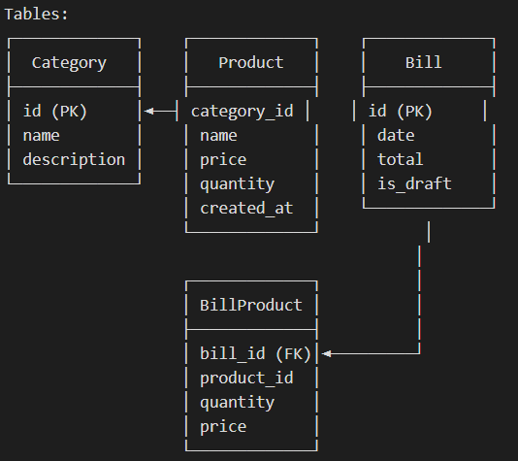
Database Architecture

Slide 6
DASHBOARD ANALYTICS
Key Metrics:
Total Revenue & Bills
Average Bill Value
Today's/Week's/Month's Sales
Product & Category Count
Interactive Charts:
Sales Trend Analysis (Line Chart)
Category Distribution (Pie Chart)
Top Products Performance (Bar Chart)
Inventory Levels (Stock Chart)
Real-time Updates:
Auto-refresh every 30 seconds
Manual refresh controls
Live notifications

Slide 7
User Interface Highlights
Modern Design:
Responsive Bootstrap 5 layout
Gradient color schemes
Font Awesome icons
Smooth animations and transitions
Navigation:
Intuitive menu structure
Easy access to all features
Mobile-friendly design
User Experience:
Real-time feedback
Loading indicators
Error handling
Success notifications

Slide 8
CORE FUNCTIONALITIES
Product Management:
CRUD operations for products
Category-based organization
Stock level monitoring
Low stock alerts
Bill Generation:
Dynamic bill creation
Multiple product selection
Professional PDF export
Draft and final states
Analytics:
Real-time data visualization
Performance metrics
Trend analysis
Inventory insights

Slide 9
TECHNICAL IMPLEMENTATION
Backend Architecture:
MVC pattern with Flask
SQLAlchemy ORM for database
RESTful API endpoints
Error handling & validation
Frontend Features:
AJAX for real-time updates
Plotly.js for interactive charts
Bootstrap for responsive design
JavaScript for dynamic content
Data Flow:
Database ➜ Flask Routes ➜ API Endpoints ➜ Frontend ➜ User Interface

Slide 10
API ENDPOINTS
Dashboard APIs:
/api/dashboard_metrics - Live metrics data
/api/sales_chart - Sales trend data
/api/category_chart - Category distribution
/api/top_products_chart - Product performance
/api/inventory_chart - Stock levels
Main Routes:
/ - Home page with product listing
/dashboard - Analytics dashboard
/create_bill - Bill creation interface
/add_product - Product management
/bill/<id>/pdf - PDF generation

Slide 11
REAL-TIME FEATURES
Auto-refresh System:
30-second automatic updates
Manual refresh controls
Toggle auto-refresh on/off
Last updated timestamps
Live Data Updates:
Metrics update without page reload
Charts refresh with new data
Recent activity tables update
Inventory alerts appear dynamically
User Controls:
Play/pause auto-refresh
Instant manual refresh
Visual update indicators
Status notifications

Slide 12
PROJECT BENIFITS
For Business:
Real-time inventory tracking
Professional bill generation
Data-driven decision making
Efficient stock management
For Users:
Intuitive interface
Mobile accessibility
Real-time feedback
Professional documentation
For Developers:
Clean, maintainable code
Scalable architecture
Modern web technologies
Best practices implementation

Slide 13
FUTURE ENHANCEMENTS
Planned Features:
Multi-user authentication system
Advanced reporting modules
Email integration for bills
Barcode scanning support
Mobile app development
Technical Improvements:
Database migration to PostgreSQL
Redis caching for better performance
API rate limiting
Advanced security features
Cloud deployment options

Slide 14
INSTALLATION AND SETUP
Prerequisites:
Python 3.12+
pip package manager
Git (for version control)
Quick Setup:
1. Clone repository from GitHub
2. Install dependencies: pip install -r requirements.txt
3. Run application: python app.py
4. Access at: http://localhost:5000
Database Setup:
SQLite database auto-created
Sample data can be added
Migrations supported via Flask-Migrate

Slide 15
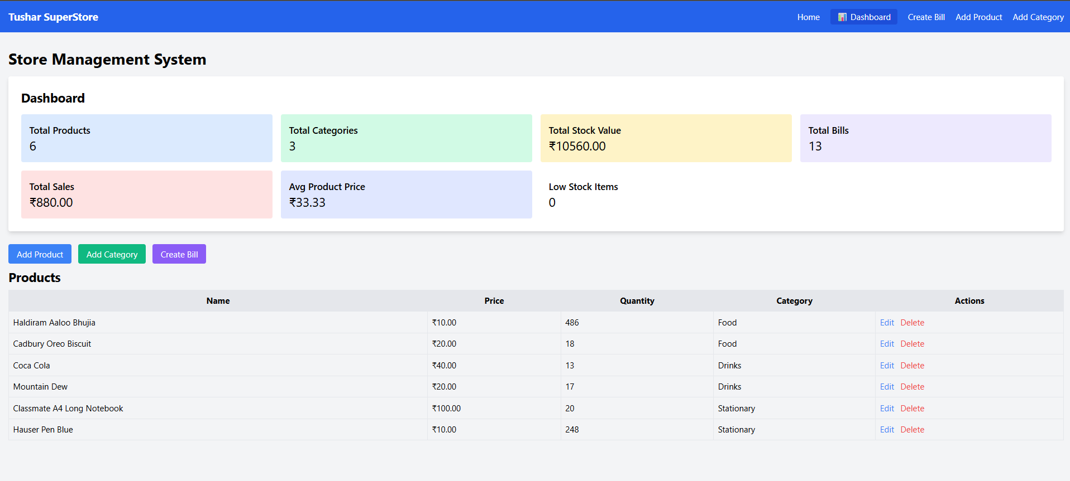
DEMO SCREENSHOTS - Homepage

Slide 16
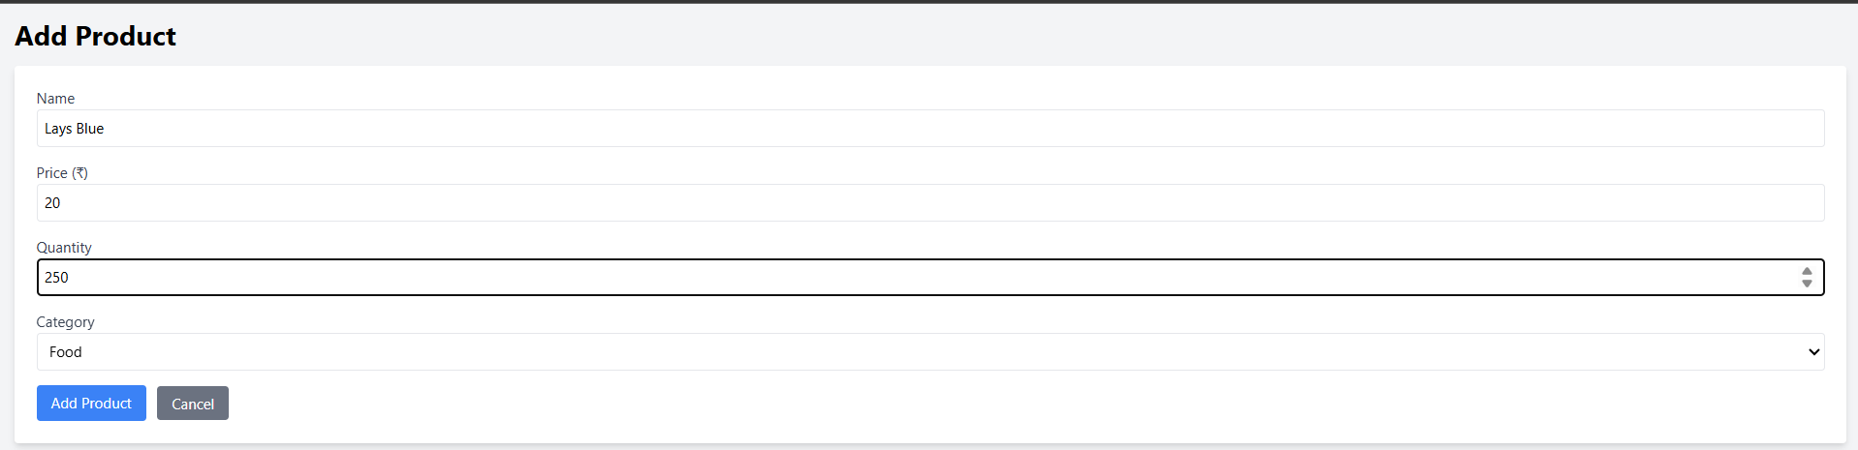
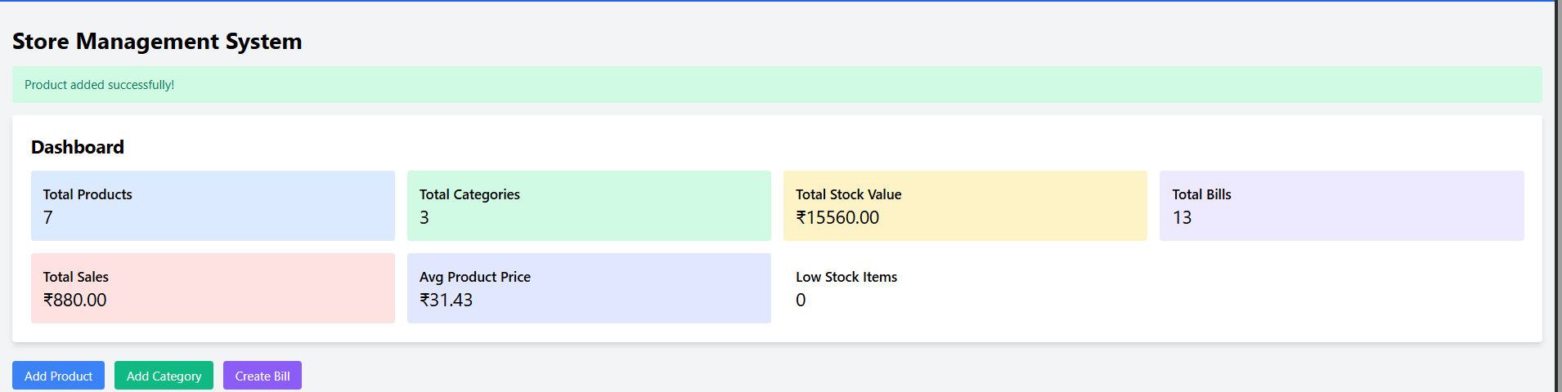
DEMO SCREENSHOTS- Add Product

Slide 17
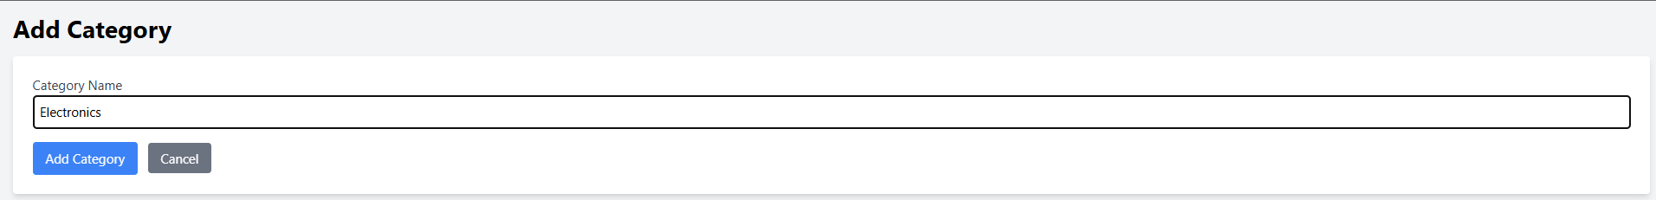
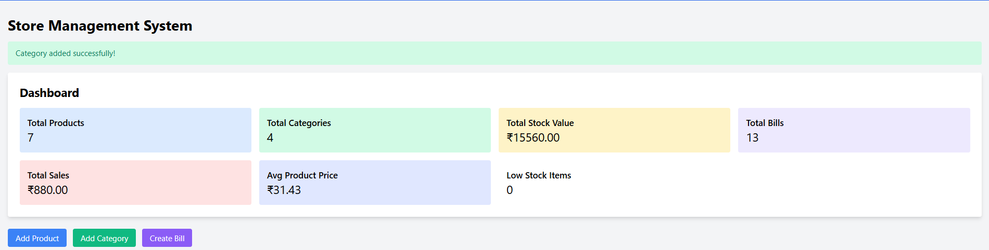
DEMO SCREENSHOTS – Add Category

Slide 18
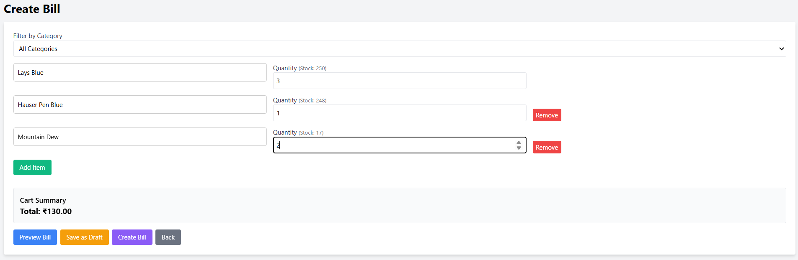
DEMO SCREENSHOTS- Creating Bill

Slide 19
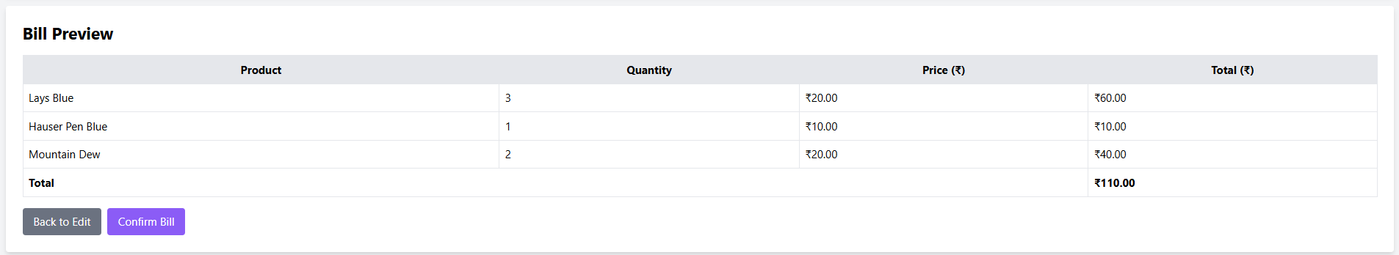
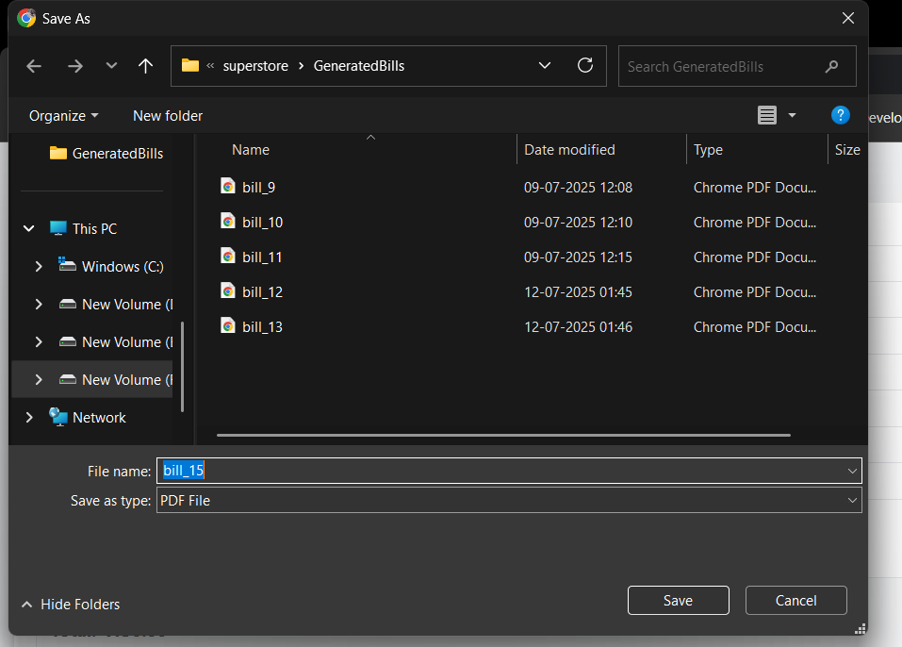
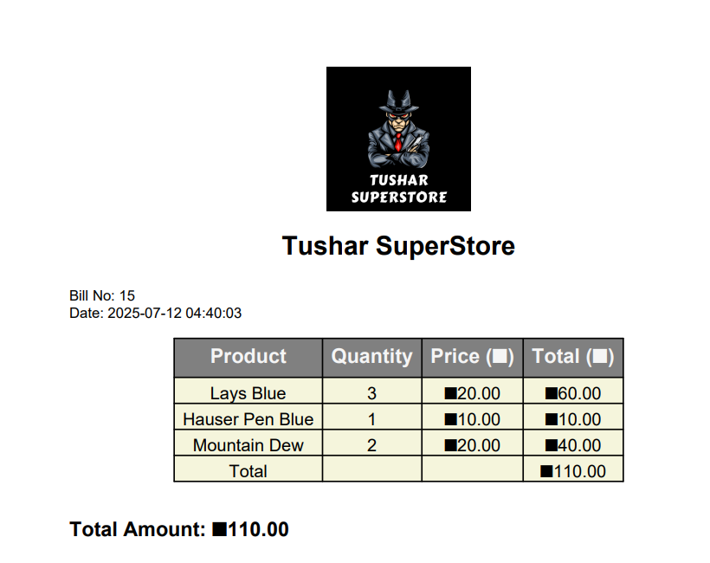
DEMO SCREENSHOTS - Billing

Slide 20
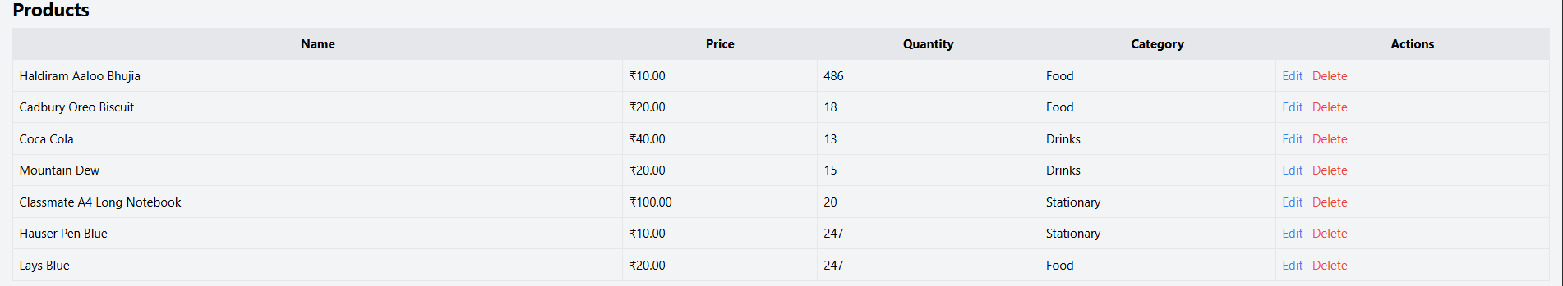
DEMO SCREENSHOTS – Updated Stock

Slide 21
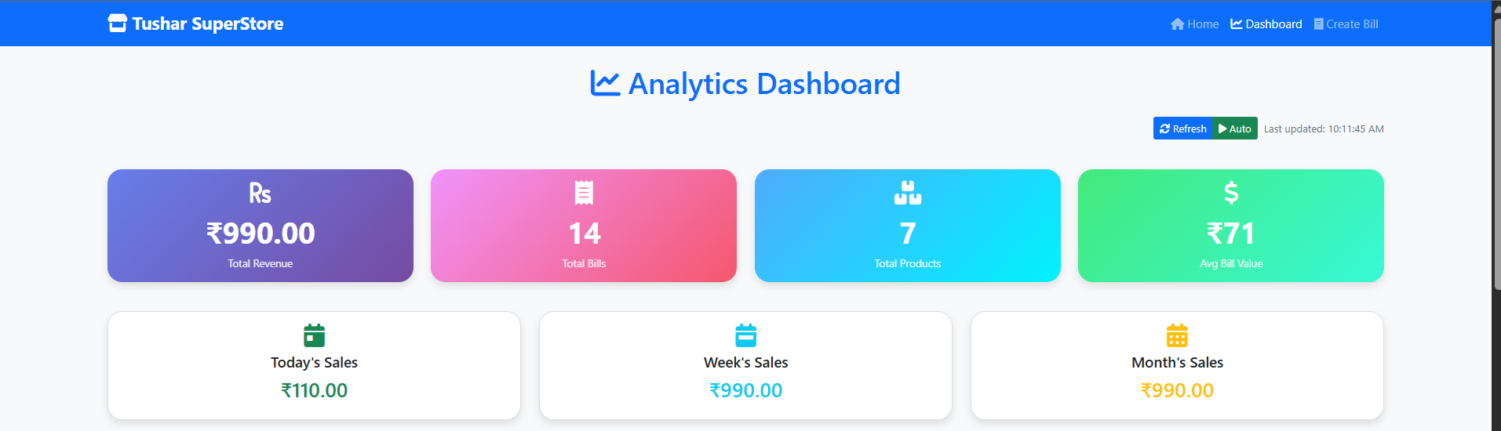
DEMO SCREENSHOTS- Dashboard

Slide 22
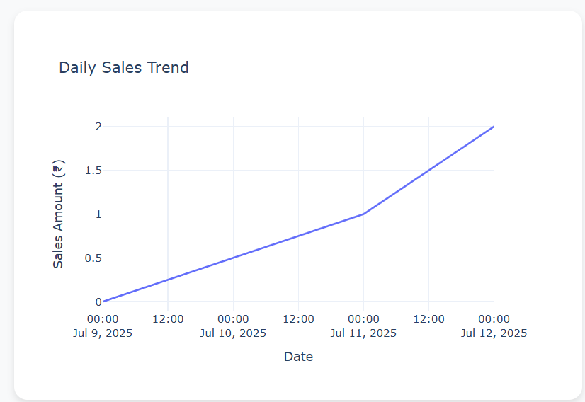
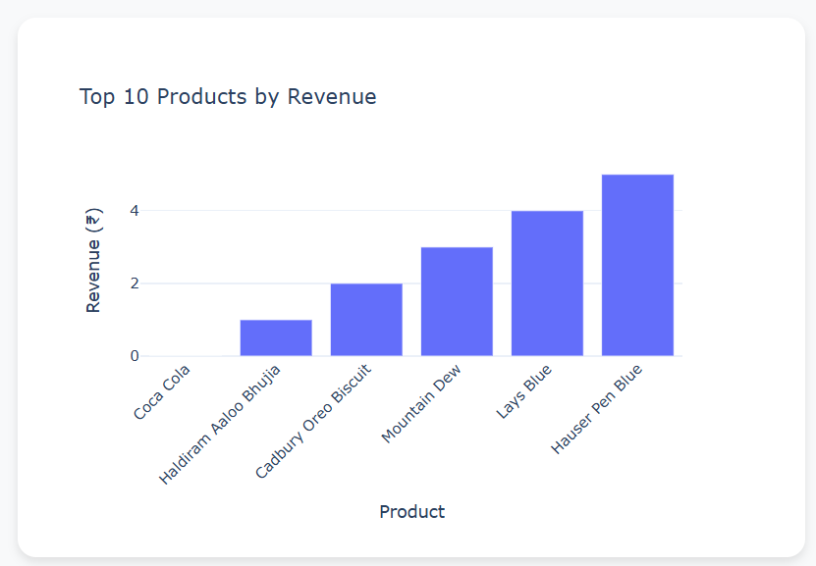
DEMO SCREENSHOTS - Dashboard

Slide 23
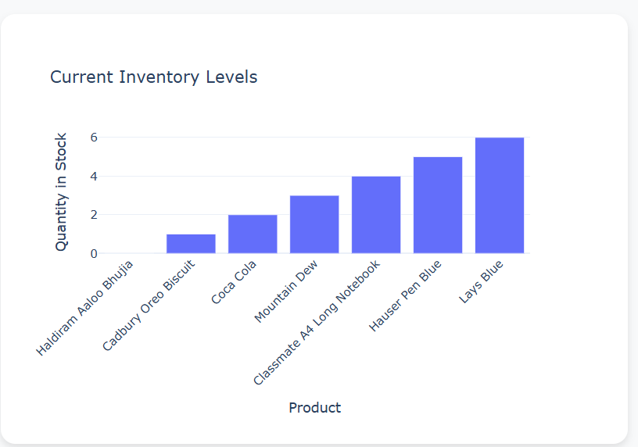
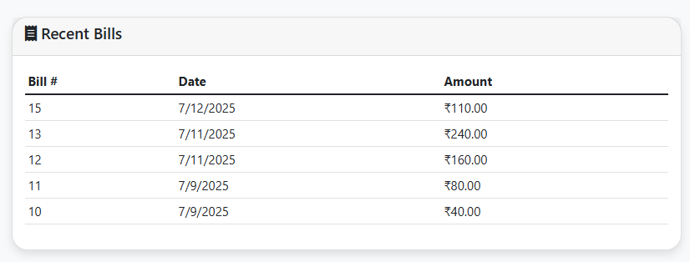
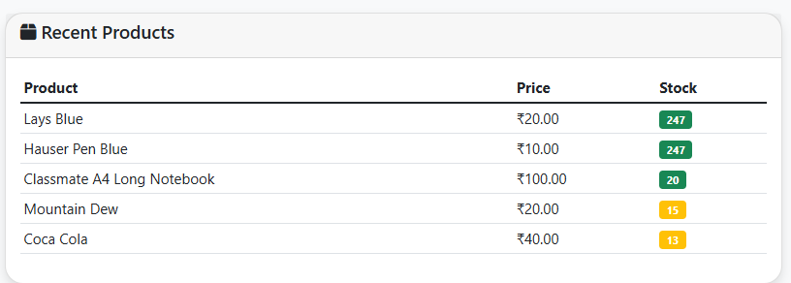
DEMO SCREENSHOTS - Dashboard

Slide 24
GITHUB REPOSITORY
github.com/tushaarmahajan/tushar-superstore
Repository Features:
Complete source code
Comprehensive documentation
Installation instructions
Contributing guidelines
MIT License for open use
Stats:
22+ files
Modern UI/UX
Multiple chart types
Real-time functionality

Slide 25
TECHNICAL ACHIEVEMENTS
Code Quality:
Clean, well-documented code
Modular architecture
Error handling & validation
Responsive design principles
Performance:
Optimized database queries
Efficient real-time updates
Fast chart rendering
Mobile-optimized interface
Best Practices:
RESTful API design
Security considerations
Version control with Git
Professional documentation

Slide 26
LEARNING OUTCOMES
Technical Skills Gained:
Full-stack web development
Database design & management
Real-time data visualization
API development & integration
PDF generation techniques
Soft Skills Developed:
Project planning & execution
Problem-solving abilities
User experience design
Documentation writing
Version control management

Slide 27
CONCLUSION
Project Success Factors:
Complete inventory management solution
Real-time analytics dashboard
Professional user interface
Mobile-responsive design
Open source contribution
Impact:
Demonstrates full-stack development skills
Showcases modern web technologies
Provides practical business solution
Ready for portfolio presentation
Suitable for real-world deployment

